Slide 1
Software Product Line Engineering in Safety-critical Domains

Slide 2
1 Motivation

Slide 3
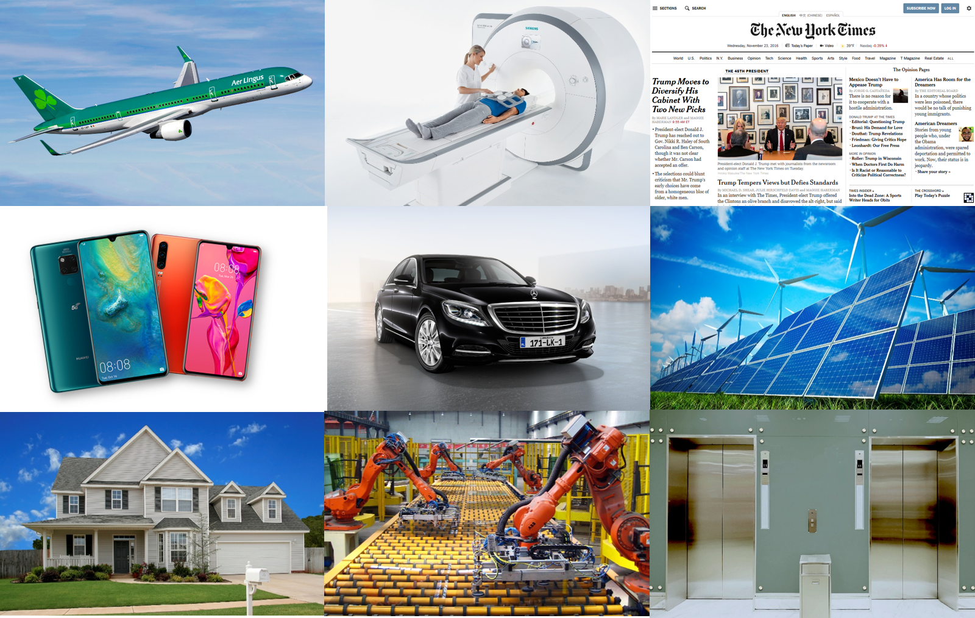
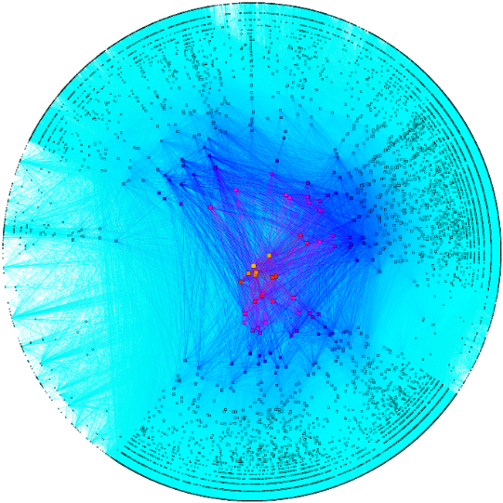
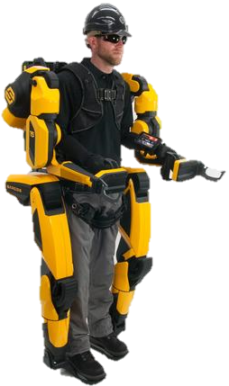
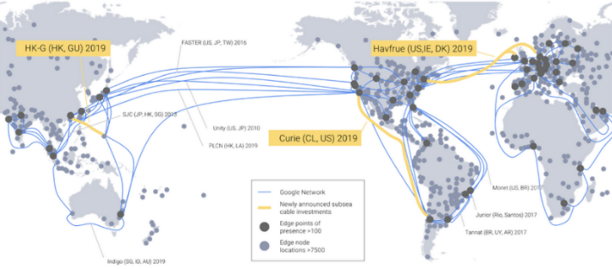
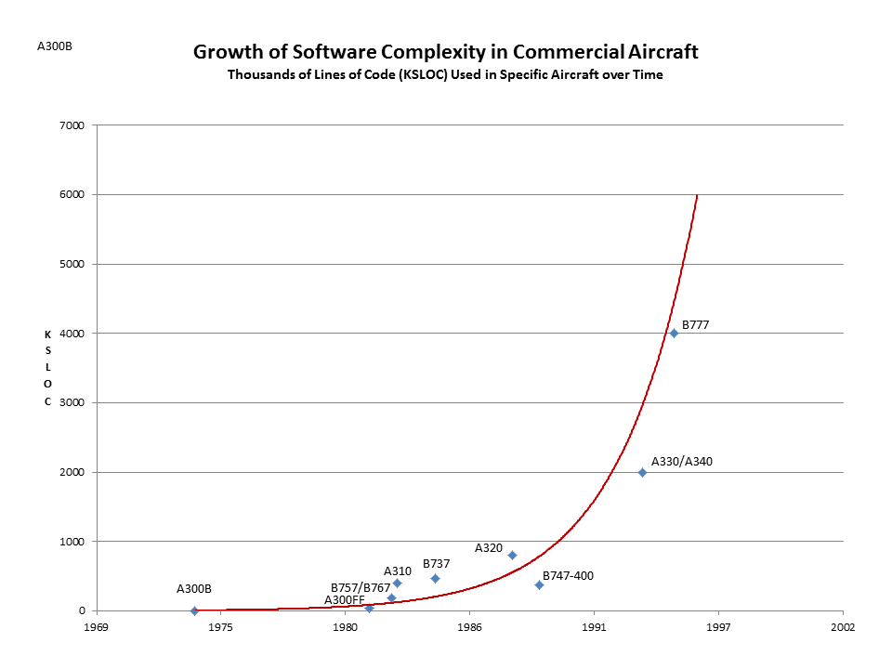
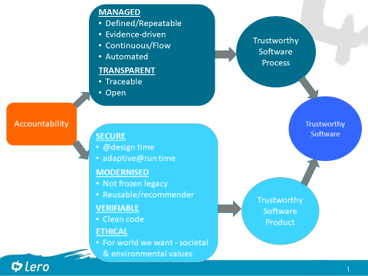
Challenges
High-level Concepts
Concrete Techniques
“Software is eating the world”
Model-driven Engineering
Abstraction
Models
Software Product Line Engineering
Complexity
Automation
Scale
Tools
AI and ML
Continuous Software Engineering
Interactive Tools
Productivity of Engineers
Certifiable
Trustworthiness
Quality
Constant Change
Automation
Market Speed
Continous SE
Repeatable

Slide 4
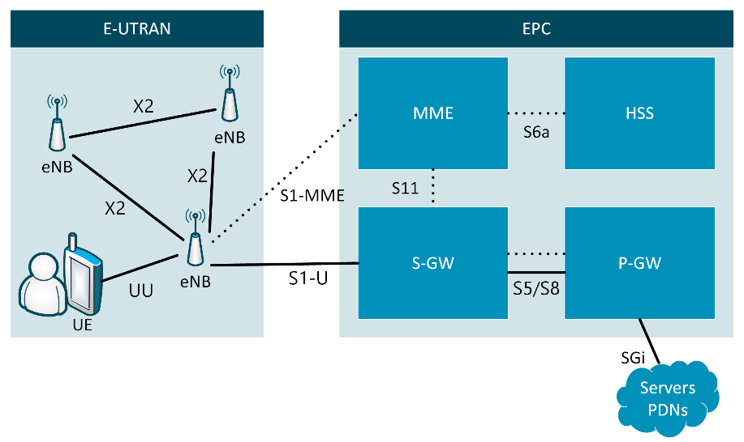
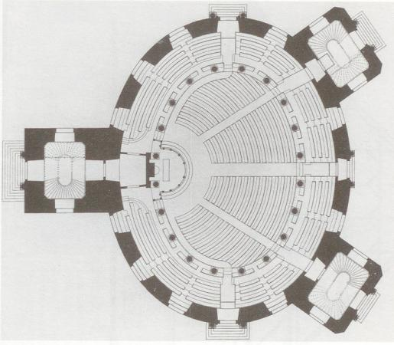
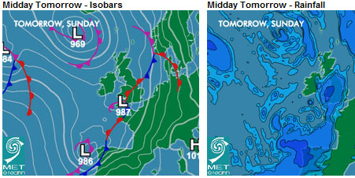
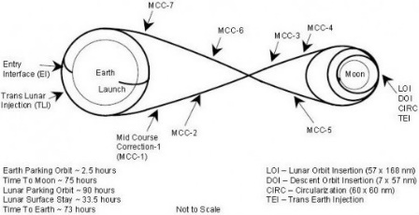


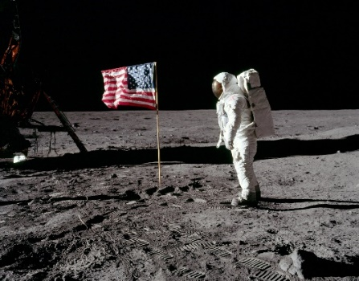

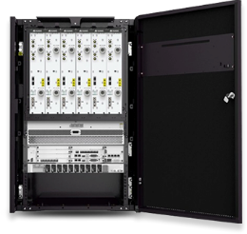


Why Models?
Construction
Weather
Spaceflight
Wireless Network
Model
Reality
Notes:
In science and engineering one way to gather knowledge and reduce complexity are models
Representation of Reality
Abstraction
Focusing on the relevant aspects → Modelling purpose
Intentionally ignoring irrelevant details
Avoiding complexity and costs of reality

Slide 5
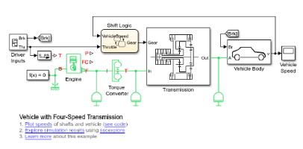


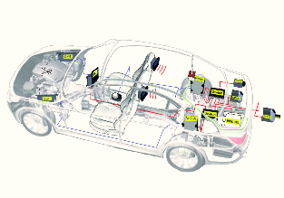
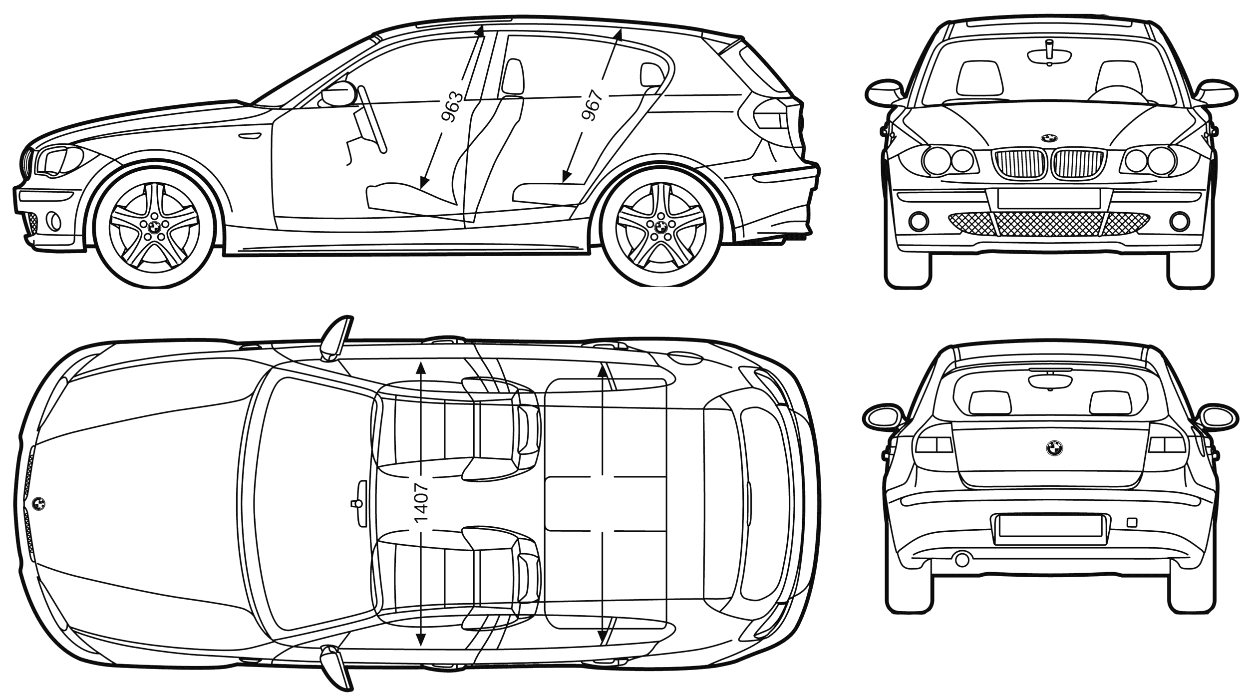
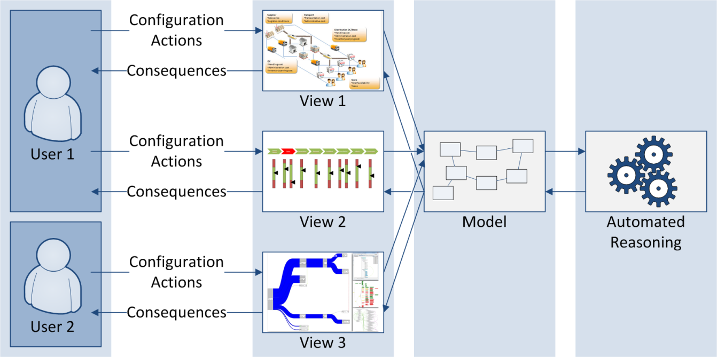
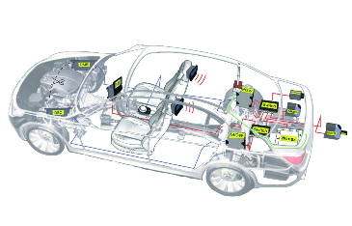
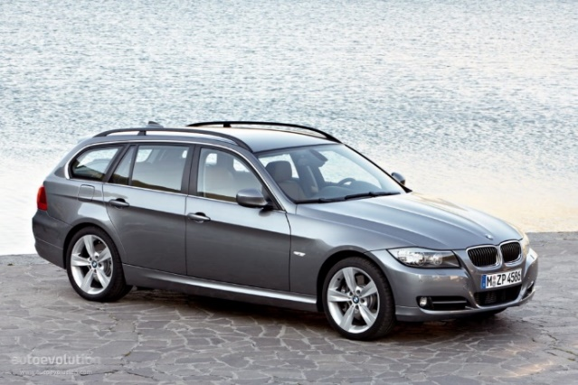
Model-driven Engineering
Visualisation, Interaction, Design
Meaningful Models for Analysis and Automation
Formal Methods, Analysis,
Validation, Transformation
OK
Cancel
User
Model
Efficient Creation, Automation
Purposeful Abstraction
Reality
[Stahl and Voelter 2006; Pleuss and Botterweck 2012]
Notes:
Representation of Reality
Abstraction
Focusing on the relevant aspects → Modelling purpose
Intentionally ignoring irrelevant details
Avoiding complexity and costs of reality
Automated generation: Just imagine constructing a house by taking a blue print and just pressing a button.

Slide 6
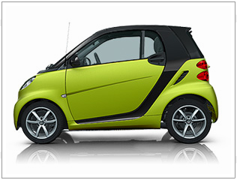
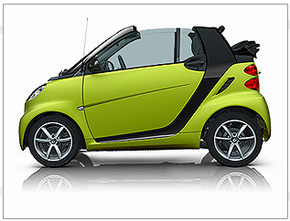
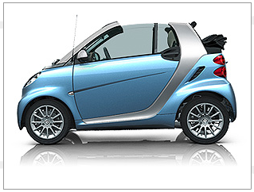
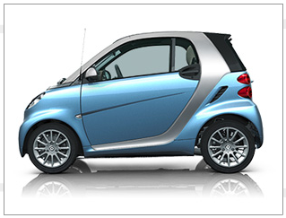
Where do Product Lines Come From?
Sucessful Product → More Products → Product Portfolio
Complexity Barrier and/or Need to Exploit Similarity (Market Pressure)
Must use Strategic Approach
Example: CelciusTech Systems (Defense, Sweden)
Awarded two large contracts simulaneuosly → had to apply strategic approach
2000 SS2000 first entry into SPLC Hall of Fame http://splc.net/fame/celsiustech-systems-ab/
[Paul Clements, ICSE 2019 Keynote]

Slide 7
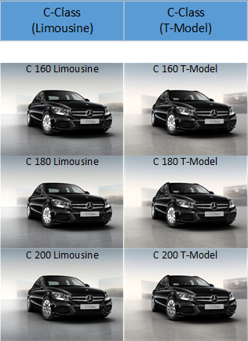
Many Variants
Source: Extracted from configurator at http://www.mercedes.de/

Slide 8
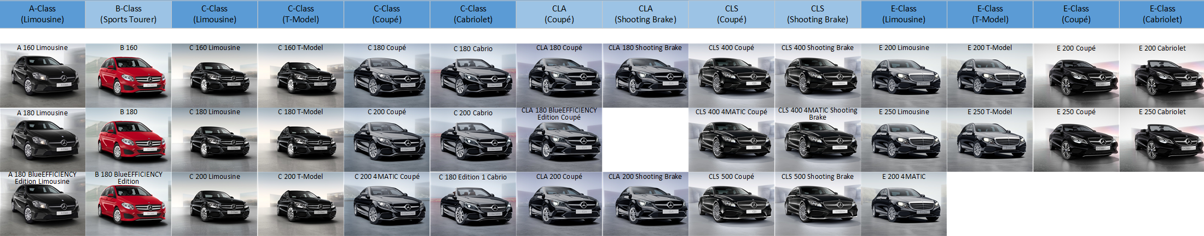
Many Variants
Source: Extracted from configurator at http://www.mercedes.de/

Slide 9
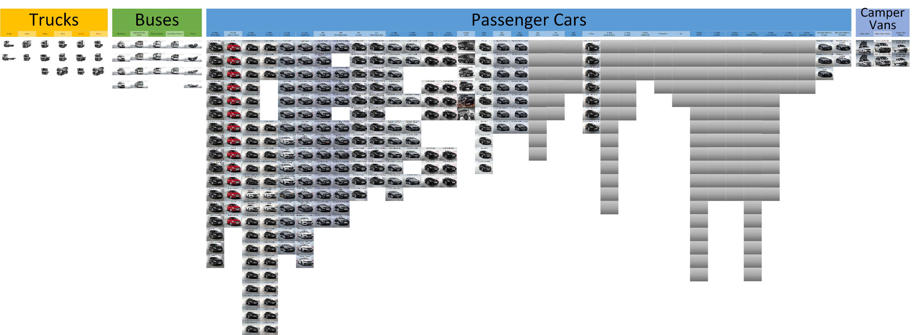
Many Variants
Source: Extracted from configurator at http://www.mercedes.de/

Slide 10

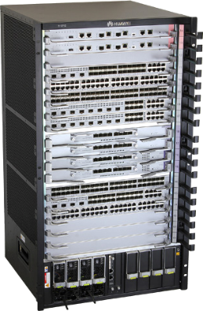
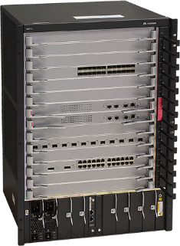

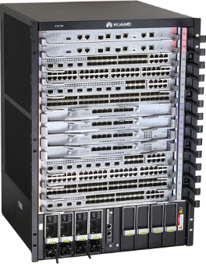
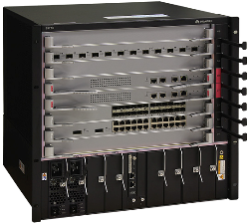


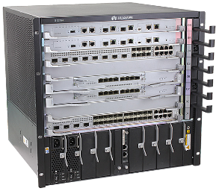
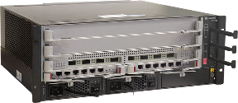

Product Lines
Huawei S9700 Series
(Network Switches)
Huawei BTS3900 Series (Wireless Network Base Transceiver Station)
Huawei S12700 Series (Network Switches)
Huawei Smartphones
Mercedes Passenger Cars

Slide 11
2 Software Product Line Engineering

Slide 12


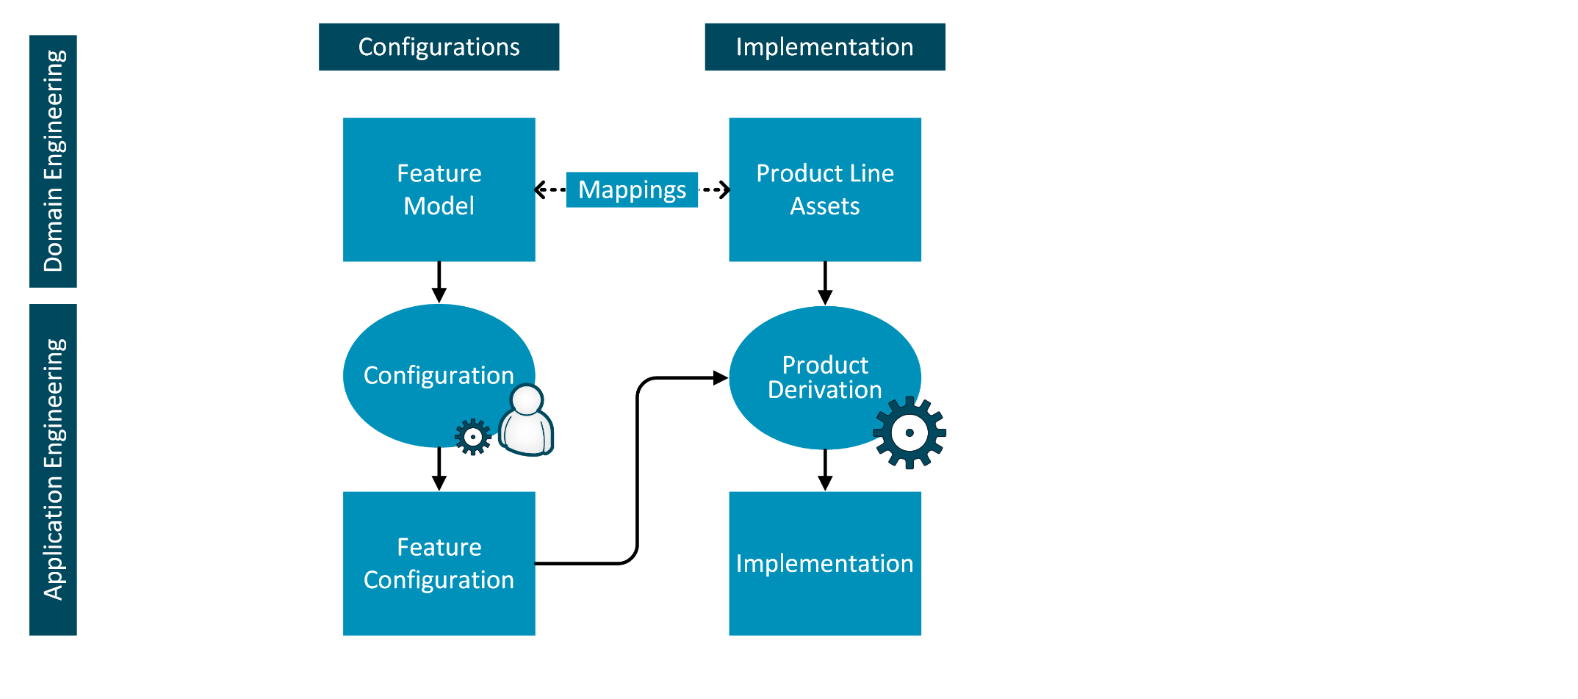
Software Product Line Engineering
[ACM Comp. Surveys 50(1), Information & Software Tech. 95; SSBSE 2016; VaMoS’14; ISSE 8(1); Software Tools for Technology Transfer 14(5)]

Slide 13
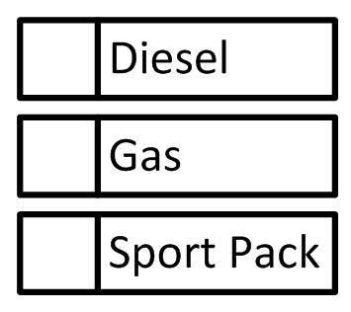

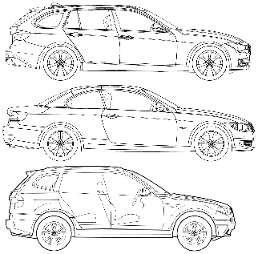
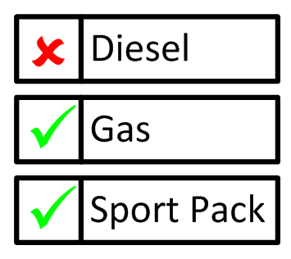
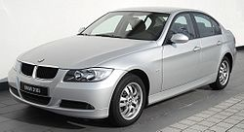
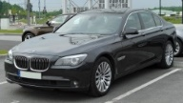
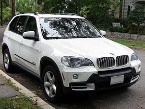
Software Product Line Engineering
[ACM Comp. Surveys 50(1), Information & Software Tech. 95; SSBSE 2016; VaMoS’14; ISSE 8(1); Software Tools for Technology Transfer 14(5)]

Slide 14
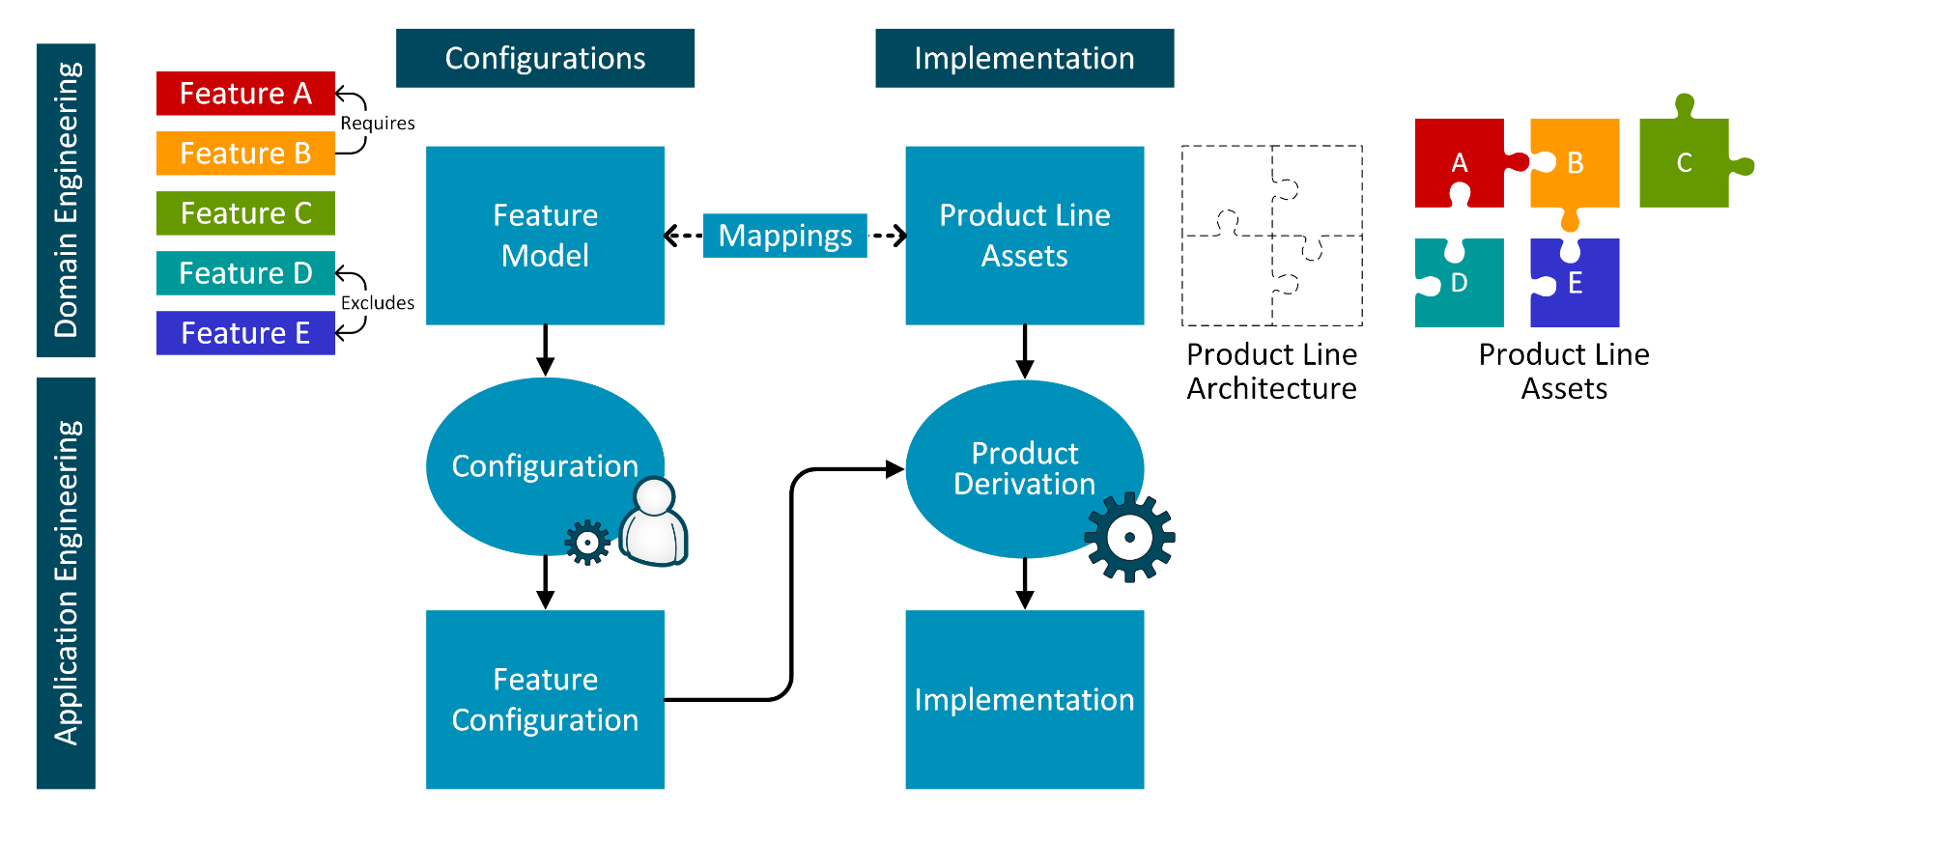
Software Product Line Engineering
[ACM Comp. Surveys 50(1), Information & Software Tech. 95; SSBSE 2016; VaMoS’14; ISSE 8(1); Software Tools for Technology Transfer 14(5)]

Slide 15
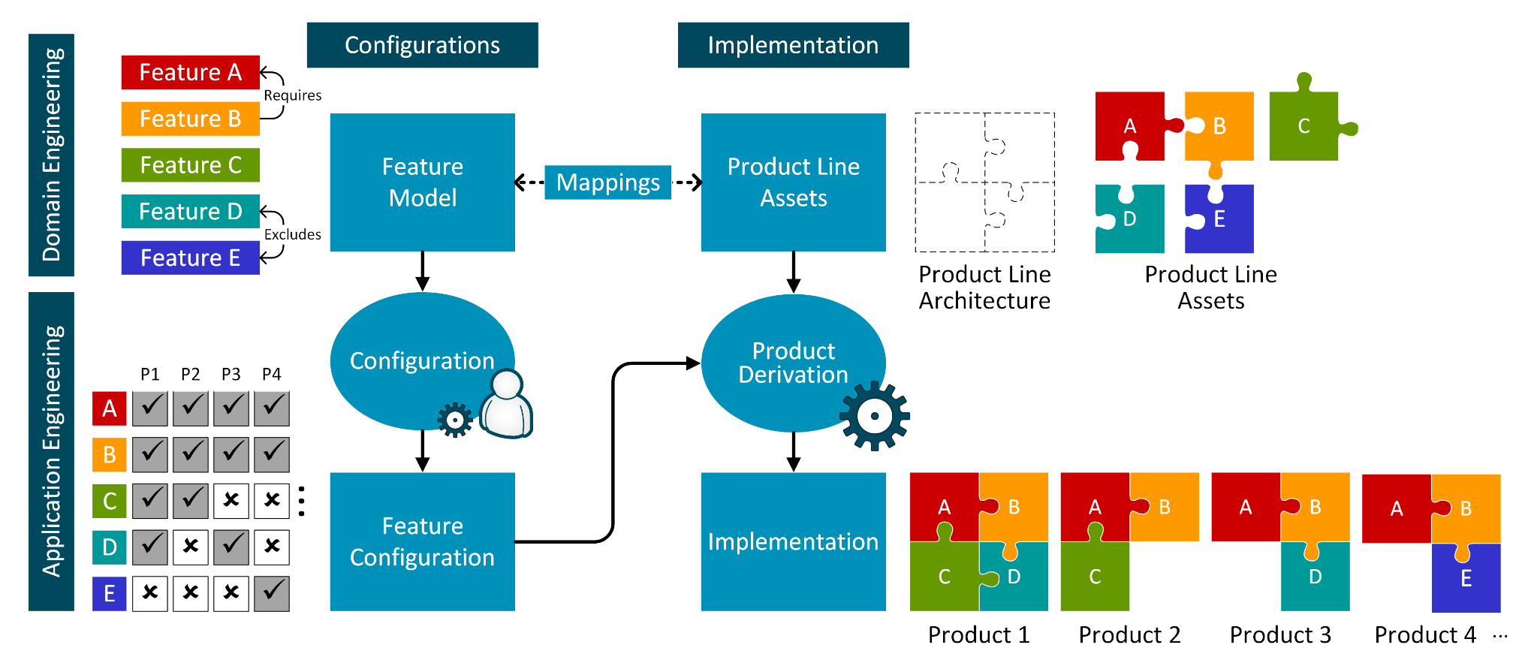
Software Product Line Engineering
[ACM Comp. Surveys 50(1), Information & Software Tech. 95; SSBSE 2016; VaMoS’14; ISSE 8(1); Software Tools for Technology Transfer 14(5)]

Slide 16
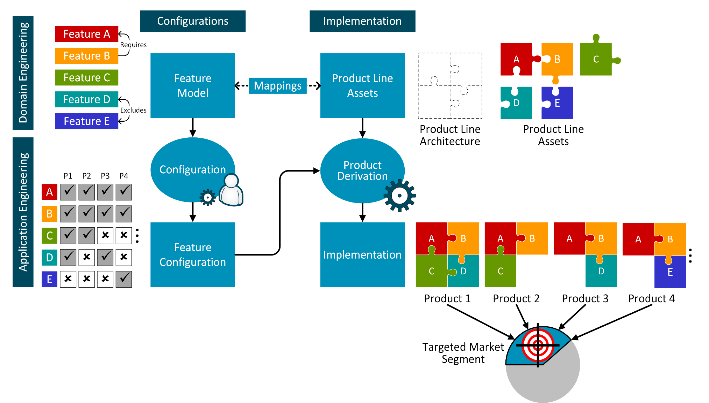
Characteristics of a Software Product Line
Sharing a common, managed set of features
Developed from a common set of core assets in a prescribed way (strategic reuse)
Mechanisms for Efficient Derivation
(Automation)
Ideally: Mechanisms for Efficient Derivation
(Automation)
Set of similar software intensive systems
Targeting a market segment (scope)
[Clements and Northrop 2002] [Botterweck et al. 2007] [Botterweck et al. 2009]

Slide 17
2.1 Product Configuration and Derivation

Slide 18
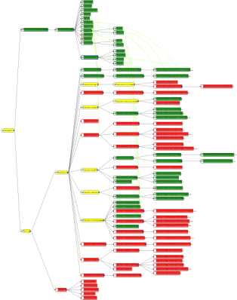
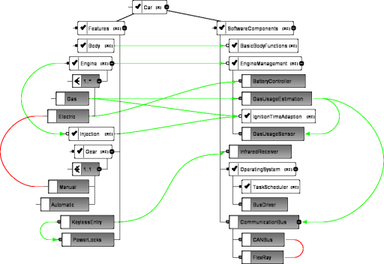
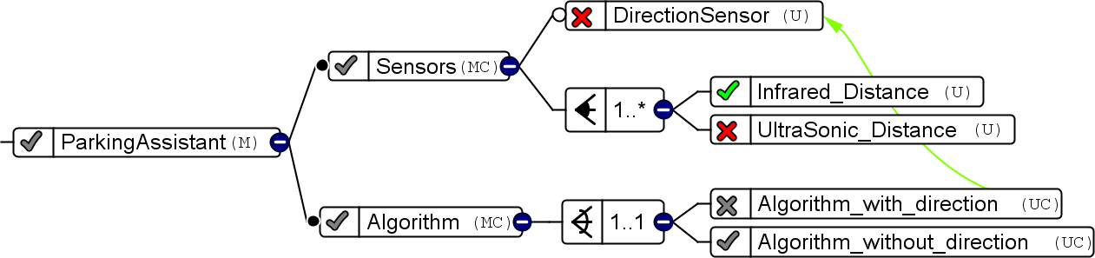
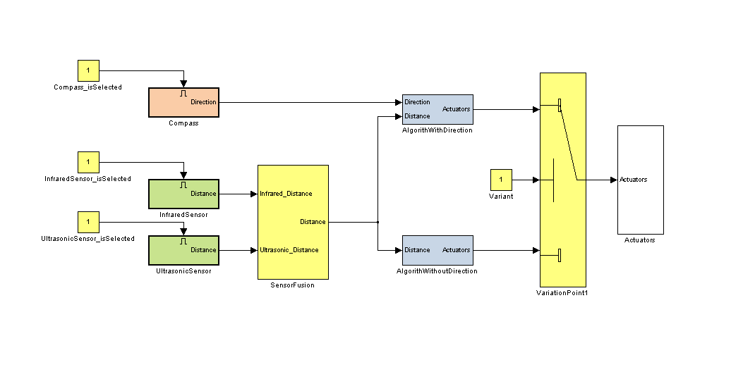
Product Configuration and Derivation
How to Support Configuration?
Interactive Configuration Tool S2T2,
Multi-objective Optimisation MILPIBEA
How to Increase Level of Automation?
Various Techniques for Model-driven SE,
Domain-specific Approaches, e.g., Embedded, Aerospace, Automotive, ...

Slide 19
2.2 Optimisation of Product Configurations

Slide 20
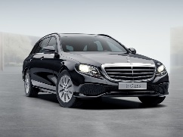
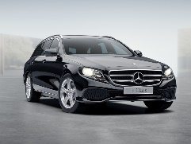
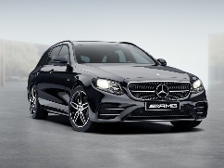
Configuration of Product Variants
Feature Model
Petrol xor Diesel
4 xor 6 cylinder
optional Sports Pack
Sports Pack requires 6 cylinder
Price [€]
Emissions [g CO₂/km]
Fuel consumption [l/100km]
configurations should conform to Feature Model
Petrol
4 Cylinder
yields product
€42,000
120 g/km
6.1 l/100km
No Sports Pack
Diesel
yields product
6 Cylinder
€55,000
136 g/km
5.2 l/100km
No Sports Pack
Petrol
6 Cylinder
yields product
€75,000
192 g/km
8.4 l/100km
Sports Pack
Notes:
One way to reduce complexity is to capture the available choices in a model
Choose product:
1) Provide interactive configurator, let user decide (but that would be another talk)
2) Look at product properties and try to find “the best” product

Slide 21
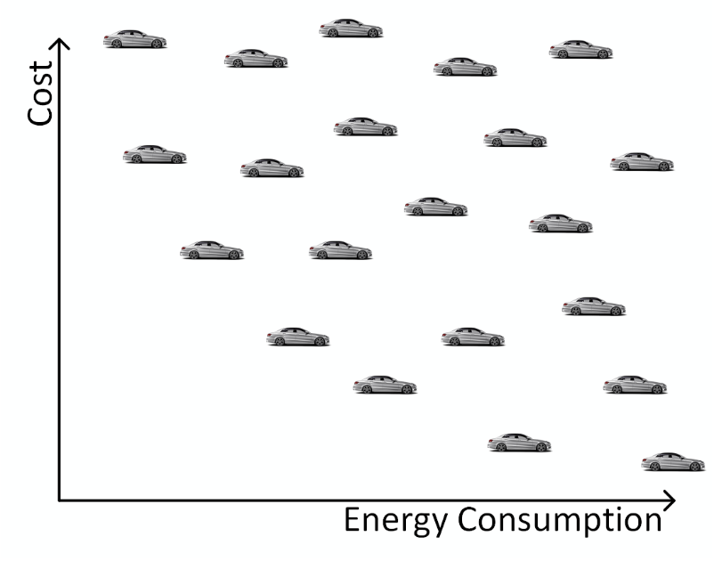
Multi-Objective Optimisation
Potential Products
Potential Products
Potential Products
Minimize
Goal: Optimize multiple objectives simultaneously
Minimize

Slide 22
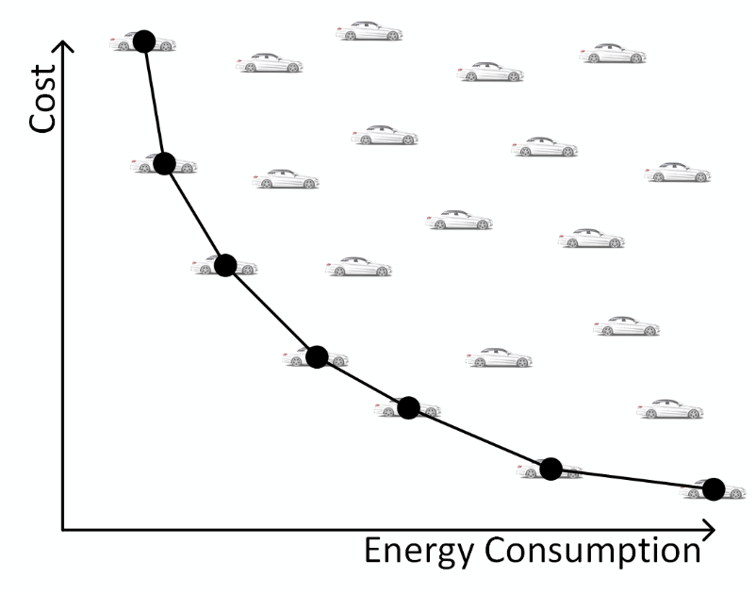
Multi-Objective Optimisation
Pareto Front
Minimize
Named after Vilfredo Pareto
(1848-1923)
Goal: Optimize multiple objectives simultaneously
Minimize

Slide 23





Multi-Objective Optimization of Configurations
SATIBEA (State-of the-art)
MILPIBEA (our approach)
IBEA (Genetic Algorithm) to search good solutions
Mutation
Cross-over
Selection
MILP (Mixed Integer Linear Progr.) to heal individuals
1% Features changed
1% Constraints changed
Healing more efficient
Healed individuals closer to original ones
Healing
Outperforms the state-of-the-art by 42%
20% Features changed
10% Constraints changed
IBEA = Indicator-Based Evolutionary Algorithm
[Brevet, Saber, Botterweck, Ventresque, SSBSE 2016]

Slide 24
3 Transition to SPLE

Slide 25
Transition to Software Product Line Engineering
[ACM Comp. Surveys 50(1), Information & Software Tech. 95; SSBSE 2016; VaMoS’14; ISSE 8(1); Software Tools for Technology Transfer 14(5)]

Slide 26
Transition to Software Product Line Engineering
Mining of PL Assets
[ACM Comp. Surveys 50(1), Information & Software Tech. 95; SSBSE 2016; VaMoS’14; ISSE 8(1); Software Tools for Technology Transfer 14(5)]

Slide 27
Transition to Software Product Line Engineering
[ACM Comp. Surveys 50(1), Information & Software Tech. 95; SSBSE 2016; VaMoS’14; ISSE 8(1); Software Tools for Technology Transfer 14(5)]

Slide 28

Transition to Software Product Line Engineering How to Manage Variants based on Clone-and-Own a.k.a. “Virtual Platform”
L6: Fully-integrated Platform
L5: Integrated Platform
L4: Feature Model
L3: Configuration
L1: Provenance
L2: Features
L0: Ad-hoc clone-and-own
[Rubin et al. 2012; Rubin et al. 2013; Rubin and Chechik 2013; Antkiewicz et al. 2014]
[ACM Comp. Surveys 50(1), Information & Software Tech. 95; SSBSE 2016; VaMoS’14; ISSE 8(1); Software Tools for Technology Transfer 14(5)]
Notes:
[11] J. Rubin and M. Chechik. A framework for managing
cloned product variants. In ICSE, 2013.
[12] J. Rubin, K. Czarnecki, and M. Chechik. Managing
cloned variants: A framework and experience. In SPLC,
2013.
[13] J. Rubin, A. Kirshin, G. Botterweck, and M. Chechik.
Managing forked product variants. In SPLC, 2012.

Slide 29
4 Product Line Evolution

Slide 30

Product Line Evolution
[Botterweck and Pleuss 2014]

Slide 31

Product Line Evolution
[Botterweck and Pleuss 2014]

Slide 32

Product Line Evolution
[Botterweck and Pleuss 2014]

Slide 33

Product Line Evolution
[Botterweck and Pleuss 2014]

Slide 34

Product Line Evolution
[Botterweck and Pleuss 2014]

Slide 35

Product Line Evolution
[Botterweck and Pleuss 2014]

Slide 36
5 Variation/Automation and Quality

Slide 37
Quality?
Correctness
Trustworthiness
...

Slide 38

Verification and Testing

Slide 39
Analyses in SPLE Product-based Analyses
Apply analyses techniques to individual products
Advantages
Easy to apply existing analysis techniques
Soundness (detected fault IS a fault of the product)
Disadvantages
Low scalability (number of products, not exploiting simiarities)
Faults in product → fault in domain-level artefacts
[ACM Comp. Surveys 50(1), Information & Software Tech. 95; SSBSE 2016; VaMoS’14; ISSE 8(1); Software Tools for Technology Transfer 14(5)]

Slide 40
Analyses in SPLE Product-based Analyses (Optimised)
Minimise set of products to analyse
E.g. coverage of pairwise combinations of features
Specific case with high practical relevance:
Optimisation of regression testing after incremental changes
Advantages
Improves scalability
Disadvantages
Need to ensure that all relevant products are analysed
Might miss faults if using heuristics
[ACM Comp. Surveys 50(1), Information & Software Tech. 95; SSBSE 2016; VaMoS’14; ISSE 8(1); Software Tools for Technology Transfer 14(5)]

Slide 41
Analyses in SPLE Family-based Analyses
Analysing the whole product line
Exploit commonality, avoid redundant computations
Examples
Family-based Static Analysis
Family-based Model Checking
Advantages
Improves scalability (faster than analyzing individual products)
Disadvantages
Existing techniques need to be adapted
Change some artifacts → Reanalyze whole PL
Might be infeasible for large PLs
Assumes closed world (implementation of all features known and fixed)
[ACM Comp. Surveys 50(1), Information & Software Tech. 95; SSBSE 2016; VaMoS’14; ISSE 8(1); Software Tools for Technology Transfer 14(5)]

Slide 42
Analyses in SPLE Feature-based Analyses
Analysing the whole product line
Exploit commonality, avoid redundant computations
Examples
Family-based Static Analysis
Family-based Model Checking
Advantages
Also supports open world scenarios
Scales well (amenable for analyses with large resource consumption)
Not affected by changes to variability model
Disadvantages
Focuses only on problems within a features, not across features (e.g., feature interactions)
[ACM Comp. Surveys 50(1), Information & Software Tech. 95; SSBSE 2016; VaMoS’14; ISSE 8(1); Software Tools for Technology Transfer 14(5)]

Slide 43
6 Successful in Practice

Slide 44
Prerequisuites
Enabling technologies: configuration/assembly of products (e.g. for software: OO, components, binding, ...)
Process maturity
Domain
Stability
Expertise, predictive knowledge
Otherwise: return on investment not possible

Slide 45

Develoment Costs
[Pohl et al. 2005, Weiss and Lai 1999]

Slide 46

Time-to-market
[Pohl et al. 2005]

Slide 47





Sucessful applied in practice, e.g.,
Avionics Systems
Engine Control Software
Marine Command and Control Systems
Telecommication Systems
Printer Firmware
RAID Storage Controllers
Financial Software
Mobile Phones
Medical Systems
Consumer Electronics
Acquisition Management Systems
Power Systems

Slide 48
Benefits of Product Lines
Complexity handling
Reduced time-to-market
Market dominance
Market agility
Product alignment
Low cost production
Low cost maintenance
Mass customization
Reduced maintenance effort
Improved Efficiency and Productivity
Increased quality
Improved predictability / estimation
[Clements and Northrop 2002, Northrop 2008]

Slide 49
7 Current Research

Slide 50
Application of Machine Learning
Machine Learing in Configuration, e.g.,
Learning a (ML approximation of a) configuration space from a limited number of configurations
Finding “similar” products

Slide 51




Design Space Exploration
Design Problems That Can be Modelled as Graphs
Civil Engineering
Aeronautical Engineering
Electrical Wiring of House
Plumbing of House
Electrical Wiring Harness of a Plane
Environmental Control System of a Plane

Slide 52

Design Space Exploration

Slide 53




Design Space Exploration
How can we support engineers to make sense of large sets of designs? Which parts can be automated?
Usability Engineering
Interactive Visualisation
Tools to Compare Large Sets of Designs
Graph Analysis
Combinations of ML and Graph Approaches (e.g., Graph Embedding)

Slide 54
Summary

Slide 55


Summary

Slide 56
Appendix

Slide 57
Interactive Configuration
[Pleuss and Botterweck 2012]

Slide 58


Interactive Visual Configuration
Interactive techniques for the configuration of large and complex feature models [BSP09]
Co-configuration of feature and component models [BPK09]
2.5D and 3D visualisations in PLE configuration [CNP+08, CBH+09, CTB+09, CBH10, CHT+10]
Visualisation of product attributes during configuration [ScBo10]

Slide 59






Product Configuration (Integration of concepts)
[BJS09] Botterweck, G.; Janota, M. and Schneeweiss, D. A Design of a Configurable Feature Model Configurator, Proceedings of the 3rd International Workshop on Variability Modelling of Software-Intensive Systems (VAMOS 09), January, 2009 , 165-168

Slide 60








Notes:
What do we see here? There’s a plane, an MRI scanner, a house, a car, …
But what I actually see is software systems. Any system in our everyday life will become a software system.
Complex
150 Mio LOC. One thousand times as much as …
100 ECU, little computers
Many different aspects to consider, e.g., fuel consumption, safety, cost of manufacturing How do we build such a complicated system?

Slide 61


Interactive Design Space Exploration

Slide 62
Product Derivation in a Embedded Systems DSL
[BPK09] Botterweck, G.; Polzer, A. and Kowalewski, S. Using Higher-order Transformations to Derive Variability Mechanism for Embedded Systems ACES-MB 2009, collocated with MODELS, Denver, CO, USA, October, 2009 , 68-82

Slide 63
Product Derivation in a Embedded Systems DSL
[BPK09] Botterweck, G.; Polzer, A. and Kowalewski, S. Using Higher-order Transformations to Derive Variability Mechanism for Embedded Systems ACES-MB 2009, collocated with MODELS, Denver, CO, USA, October, 2009 , 68-82

Slide 64

Product Derivation in a Embedded Systems DSL
[BPK09] Botterweck, G.; Polzer, A. and Kowalewski, S. Using Higher-order Transformations to Derive Variability Mechanism for Embedded Systems ACES-MB 2009, collocated with MODELS, Denver, CO, USA, October, 2009 , 68-82

Slide 65

SEI Adoption Factory Pattern
[Clements et al. 2006, Northrop 2008]

